Slide 1

Chapter 8
Software Testing: A Craftsman’s Approach, 4th Edition Chapter 8 Path Testing
Path Testing

Slide 2
Outline
Preliminaries
Program graphs
DD-Paths
Test coverage metrics
Basis path testing
Essential complexity (from McCabe)
Software Testing: A Craftsman’s Approach, 4th Edition Chapter 8 Path Testing

Slide 3
Code-Based (Structural) Testing
Complement of/to Specification-based (Functional) Testing
Based on Implementation
Powerful mathematical formulation
  program graph
  define-use path
  Program slices
Basis for Coverage Metrics (a better answer for gaps and redundancies)
Usually done at the unit level
Not very helpful to identify test cases
Extensive commercial tool support

Slide 4
Path Testing
Paths derived from some graph construct.
When a test case executes, it traverses a path.
Huge number of paths implies some simplification is needed.
Big Problem: infeasible paths.
By itself, path testing can lead to a false sense
of security.

Slide 5
Common Objection to Path-Based Testing
(Trillions of Paths)
first
A
B
If the loop executes up to 18 times, there are 4.77 Trillion paths. Impossible, or at least, infeasible, to test them all. [Schach]
5⁰ + 5¹ + 5² + … + 5¹⁸ = 4,768,371,582,030
C
D
E
F
G
last
Stephen R. Schach, Software Engineering, , (2nd edition)
Richard D. Irwin, Inc. and Aksen Associates, Inc. 1993

Slide 6
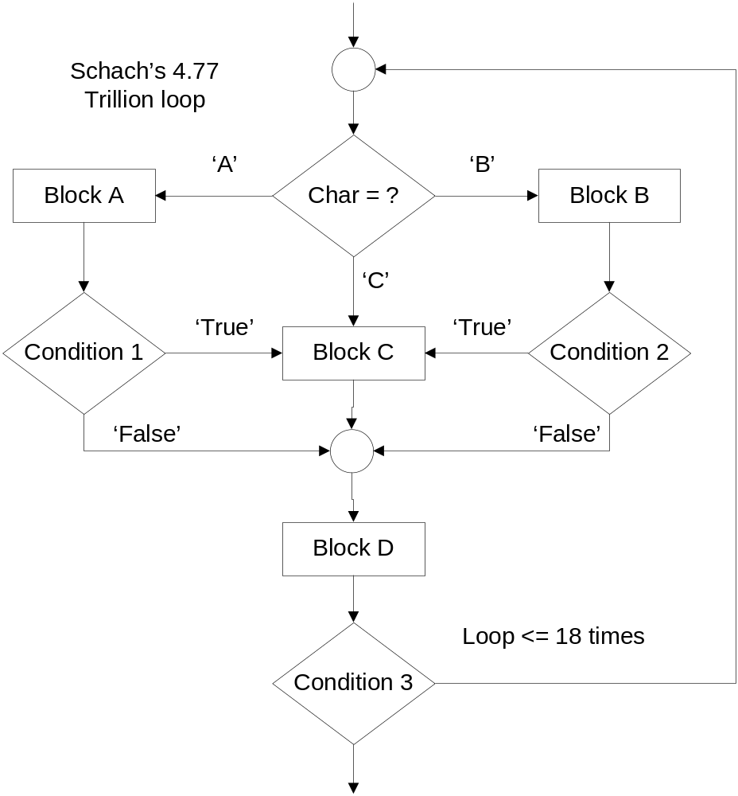
Schach’s flowchart

Slide 7
Test Cases for Schach’s “Program”
first
First-A-B-C-F-G-Last
First-A-B-C-D-F-G-Last
First-A-B-D-F-G-A-B-D-F-G-Last
First-A-B-E-F-G-Last
First-A-B-E-D-F-G-Last
These test cases cover
Every node
Every edge
Normal repeat of the loop
Exiting the loop
A
B
C
D
E
F
G
last

Slide 8
Program Graphs
Definition: Given a program written in an imperative programming language, its program graph is a directed graph in which nodes are statement fragments, and edges represent flow of control. (A complete statement is a “default” statement fragment.)

Slide 9
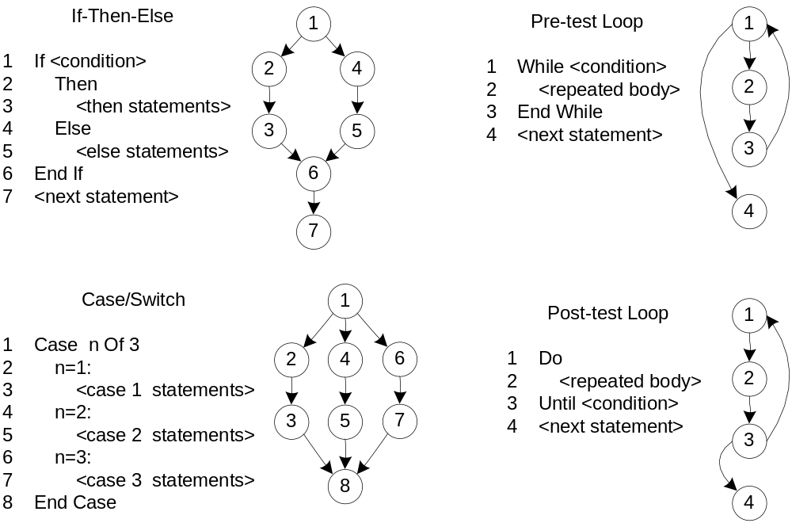
Program Graphs of Structured
Programming Constructs

Slide 10
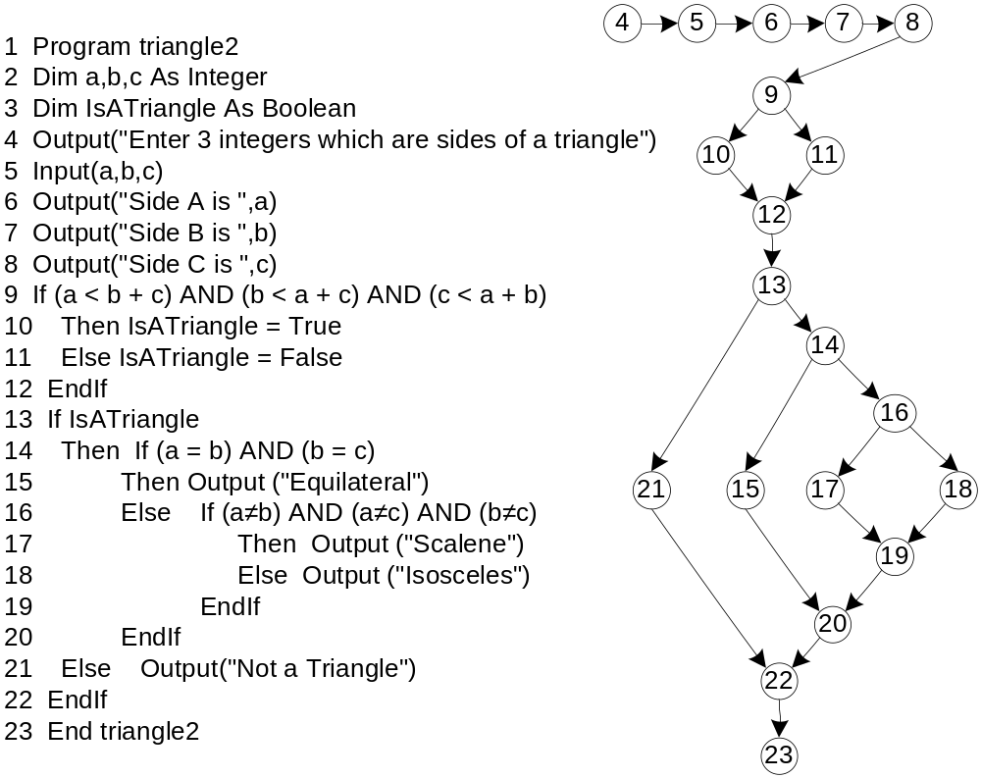
Sample Program Graph

Slide 11
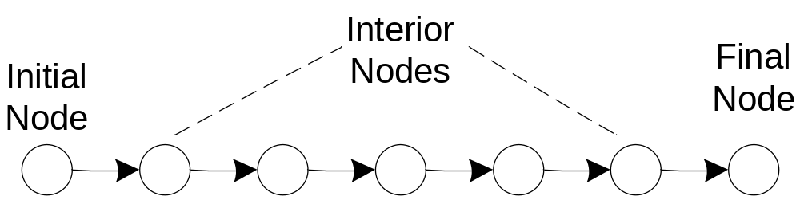
DD-Paths
Originally defined by E. F. Miller (1977?)
“DD” is short for “decision to decision”
Original definition was for early (second generation) programming languages
Similar to a “chain” in a directed graph
Bases of interesting test coverage metrics

Slide 12
DD-Paths
A DD-Path (decision-to-decision) is a chain in a program graph such that
  Case 1: it consists of a single node with indeg = 0,
  Case 2: it consists of a single node with outdeg = 0,
  Case 3: it consists of a single node with indeg ≥ 2 or outdeg ≥ 2,
  Case 4: it consists of a single node with indeg = 1 and
  outdeg = 1,
  Case 5: it is a maximal chain of length ≥ 1.

Slide 13
DD-Path Graph
Given a program written in an imperative language, its DD-Path graph is the directed graph in which nodes are DD-Paths of its program graph, and edges represent control flow between successor DD-Paths.
a form of condensation graph
2-connected components are collapsed into
an individual node
single node DD-Paths (corresponding to Cases
1 - 4 ) preserve the convention that a
statement fragment is in exactly one DD-Path

Slide 14
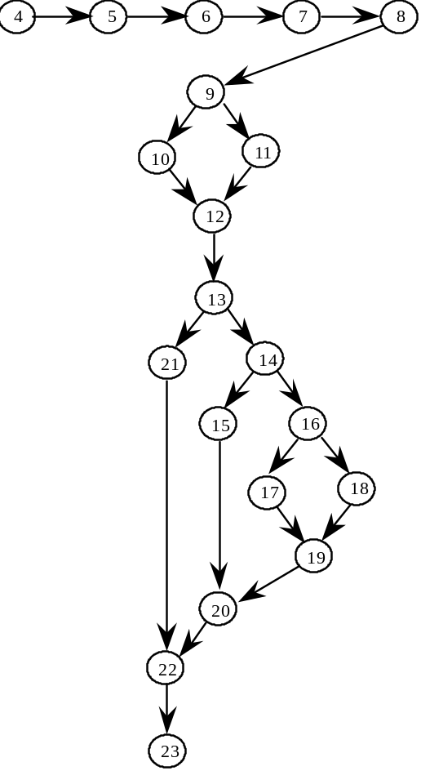
DD-Path Graph of the Triangle Program
(not much compression because this example is control intensive, with little sequential code.)

Slide 15
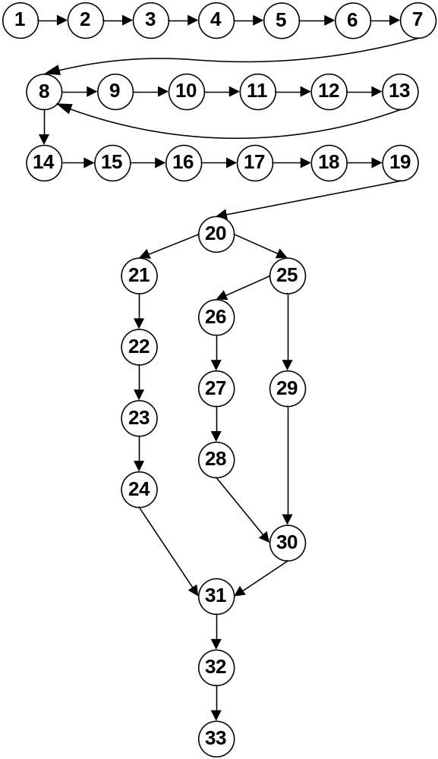
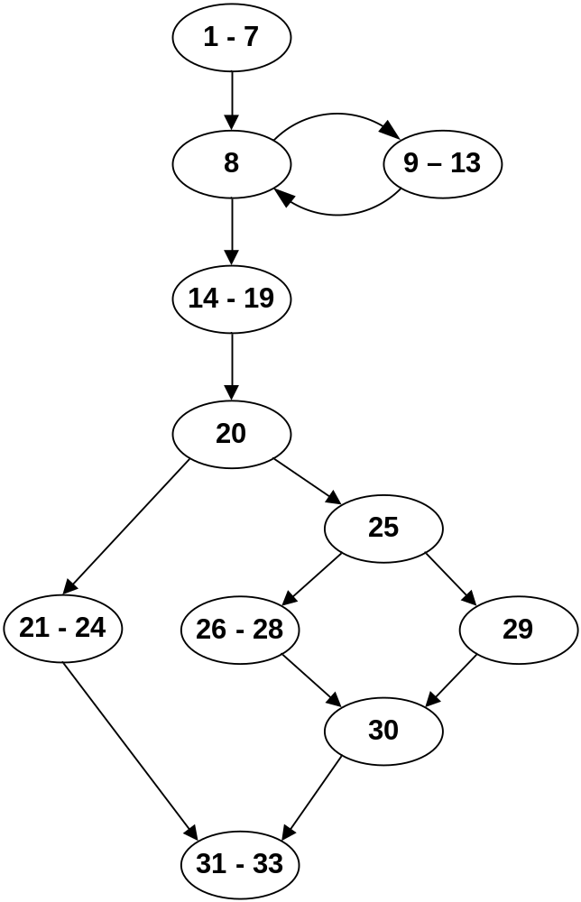
DD-Path Graph of Commission Problem

Slide 16
Exercises and Questions
Compute the cyclomatic complexity of
  the commission problem program graph
  the commission problem DD-Path graph
Are the complexities equal?
Repeat this for the Triangle Program examples
What conclusions can you draw?

Slide 17
For the mathematically inclined...
Theorem: The cyclomatic complexities of a Program Graph and its corresponding DD-Path graph are equal.
Can you give a constructive proof?
Try a proof by induction on the length of a DD-Path, where the length is the number of nodes in the program graph that are compressed into a chain.

Slide 18
Code-Based Test Coverage Metrics
Used to evaluate a given set of test cases
Often required by
  contract
  U.S. Department of Defense
  company-specific standards
Elegant way to deal with the gaps and redundancies that are unavoidable with specification-based test cases.
BUT
  coverage at some defined level may be misleading
  coverage tools are needed

Slide 19
Code-Based Test Coverage Metrics
(E. F. Miller, 1977 dissertation)
C₀: Every statement
C₁: Every DD-Path
C_{1p}: Every predicate outcome
C₂: C₁ coverage + loop coverage
C_{d}: C₁ coverage +every pair of dependent
DD-Paths
C_{MCC}: Multiple condition coverage
C_{ik}: Every program path that contains up
to k repetitions of a loop (usually k = 2)
C_{stat}: "Statistically significant" fraction of
paths
C∞: All possible execution paths

Slide 20
Test Coverage Metrics from Program Graphs
Every node
Every edge
Every chain
Every path
How do these compare with Miller’s coverage metrics?

Slide 21
Testing Loops
Huang's Theorem: (Paraphrased)
Everything interesting will happen in two loop traversals: the normal loop traversal and the exit from the loop.
Exercise:
Discuss Huang's Theorem in terms of graph based coverage metrics.

Slide 22
Concatenated, Nested, and Knotted Loops
first
A
B
C
D
last

Slide 23
Strategy for Loop Testing
Huang’s theorem suggests/assures 2 tests per loop is sufficient. (Judgment required, based on reality of the code.)
For nested loops:
  Test innermost loop first
  Then “condense” the loop into a single node (as in condensation graph, see Chapter 4)
  Work from innermost to outermost loop
For concatenated loops: use Huang’s Theorem
For knotted loops: Rewrite! (see McCabe’s cyclomatic and essential complexity)

Slide 24
Multiple Condition Testing
Consider the multiple condition as a logical proposition, i.e., some logical expression of simple conditions.
Make the truth table of the logical expression.
Convert the truth table to a decision table.
Develop test cases for each rule of the decision table (except the impossible rules, if any).
Next 3 slides: multiple condition testing for
  If (a < b + c) AND (b < a + c) AND (c < a + b)
  Then IsATriangle = True
  Else IsATriangle = False
  Endif

Slide 25
Truth Table for Triangle Inequality
(a<b+c) AND (b<a+c) AND (c<a+b)
(a<b+c) | (b<a+c) | (c<a+b) | (a<b+c) AND (b<a+c) AND (c<a+b)
T | T | T | T
T | T | F | F
T | F | T | F
T | F | F | F
F | T | T | F
F | T | F | F
F | F | T | F
F | F | F | F

Slide 26
Decision Table for
(a<b+c) AND (b<a+c) AND (c<a+b)
c1: a<b+c | T | T | T | T | F | F | F | F
c2: b<a+c | T | T | F | F | T | T | F | F
c3: c<a+b | T | F | T | F | T | F | T | F
a1: impossible |  |  |  | X |  | X | X | X
a2:Valid test case # | 1 | 2 | 3 |  | 4

Slide 27
Multiple Condition Test Cases for
(a<b+c) AND (b<a+c) AND (c<a+b)
Test Case |  | a | b | c | expected output
1 | all true | 3 | 4 | 5 | TRUE
2 | c ≥ a + b | 3 | 4 | 9 | FALSE
3 | b ≥ a + c | 3 | 9 | 4 | FALSE
4 | a ≥ b + c | 9 | 3 | 4 | FALSE
Note: could add test cases for c = a + b,
b = a + c, and a = b + c.

Slide 28
Program Graph for the Triangle Program

Slide 29
Dependent DD-Paths
(often correspond to infeasible paths)
Look at the Triangle Program code and program graph
If a path traverses node 10 (Then IsATriangle = True), then it must traverse node 14.
Similarly, if a path traverses node 11 (Else IsATriangle = False), then it must traverse node 21.
Paths through nodes 10 and 21 are infeasible.
Similarly for paths through 11 and 14.
Hence the need for the C_{d} coverage metric.

Slide 30
Test Coverage for Compound Conditions
Extension of/to Multiple Condition Testing
Modified Condition Decision Coverage (MCDC)
Required for “Level A” software by DO-178B
Three variations*
  Masking MCDC
  Unique-Cause MCDC
  Unique-Cause + Masking MCDC
Masking MCDC is
  the weakest of the three, AND
  is recommended for DO-178B compliance
* Chilenski, John Joseph, "An Investigation of Three Forms of the Modified Condition Decision Coverage (MCDC) Criterion," DOT/FAA/AR-01/18, April 2001.
[http://www.faa.gov/about/office_org/headquarters_offices/ang/offices/tc/library/ ]

Slide 31
Chilenski’s Definitions
Conditions can be either simple or compound
  isATriangle is a simple condition
  (a < b + c) AND (b < a + c) is a compound condition
Conditions are strongly coupled if changing one always changes the other.
  (x = 0) and (x ≠ 0) are strongly coupled in
    ((x = 0) AND a) OR ((x ≠ 0) AND b)
Conditions are weakly coupled if changing one may change one but not all of the others.
  All three conditions are weakly coupled in
  ( (x = 1) OR (x = 2) OR (x = 3) )
“Masking” is based on the Domination Laws
  (x AND false)
  (x OR true)

Slide 32
MCDC requires...
Every statement must be executed at least once,
Every program entry point and exit point must be invoked at least once,
All possible outcomes of every control statement are taken at least once,
Every non-constant Boolean expression has been evaluated to both True and False outcomes,
Every non-constant condition in a Boolean expression has been evaluated to both True and False outcomes, and
Every non-constant condition in a Boolean expression has been shown to independently affect the outcomes (of the expression).

Slide 33
MCDC Variations
“Unique-Cause MCDC [requires] a unique cause (toggle a single condition and change the expression result) for all possible (uncoupled) conditions.”
“Unique-Cause + Masking MCDC [requires] a unique cause (toggle a single condition and change the expression result) for all possible (uncoupled) conditions. In the case of strongly coupled conditions, masking [is allowed} for that condition only, i.e., all other (uncoupled) conditions will remain fixed.”

Slide 34
MCDC Variations (continued)
“Masking MCDC allows masking for all conditions, coupled and uncoupled. (toggle a single condition and change the expression result) for all possible (uncoupled) conditions. In the case of strongly coupled conditions, masking [is allowed} for that condition only (i.e., all other (uncoupled) conditions will remain fixed.”

Slide 35
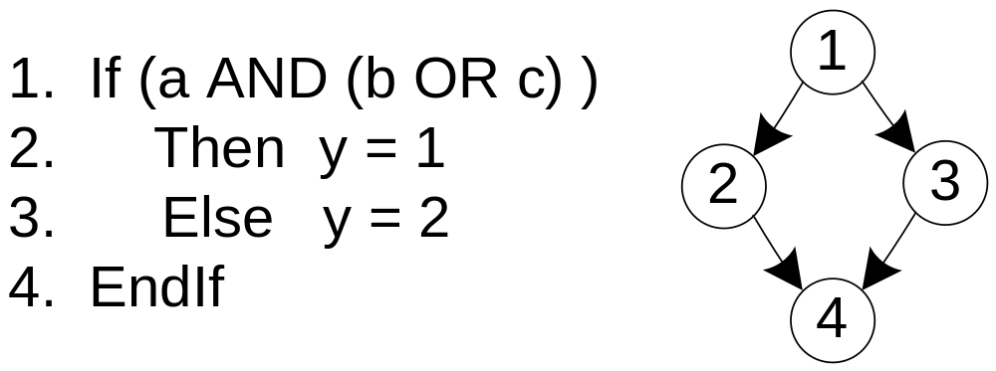
Example

Slide 36
Decision Table for (a AND (b OR c))
Conditions | rule 1 | rule 2 | rule 3 | rule 4 | rule 5 | rule 6 | rule 7 | rule 8
a | T | T | T | T | F | F | F | F
b | T | T | F | F | T | T | F | F
c | T | F | T | F | T | F | T | F
a AND (b OR c) | True | True | True | False | False | False | False | False
Actions
y = 1 | x | x | x | — | — | — | — | —
y = 2 | — | — | — | x | x | x | x | x

Slide 37
For MCDC Coverage of (a AND (b OR c))
Rules 1 and 5 toggle condition a
Rules 2 and 4 toggle condition b
Rules 3 and 4 toggle condition c
If we expand (a AND (b OR c)) to
((a AND b) OR (a AND C)), we cannot do unique cause testing on variable a because it appears in both sub-expressions.

Slide 38
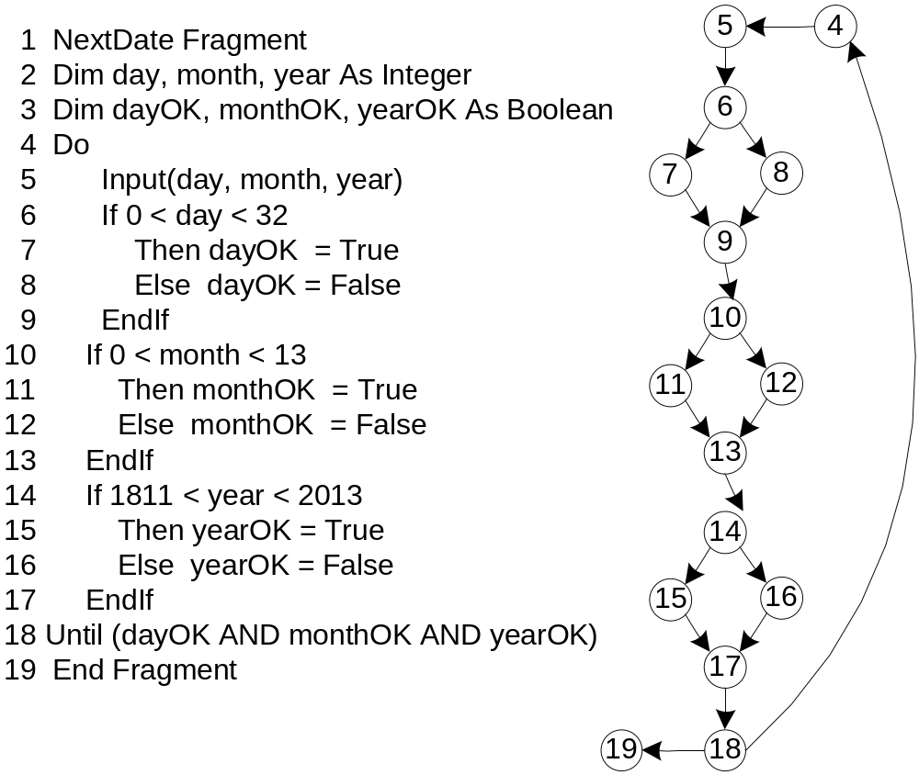
A NextDate Example

Slide 39
Corresponding Decision Table
Conditions | rule 1 | rule 2 | rule 3 | rule 4 | rule 5 | rule 6 | rule 7 | rule 8
dayOK | T | T | T | T | F | F | F | F
monthOK | T | T | F | F | T | T | F | F
YearOK | T | F | T | F | T | F | T | F
The Until condition | True | False | False | False | False | False | False | False
Actions
Leave the loop | x | — | — | — | — | — | — | —
Repeat the loop | — | x | x | x | x | x | x | x

Slide 40
Test Cases and Coverage
Decision Coverage: Rule 1 and any of Rules 2 – 8
Multiple Condition Coverage: all eight rules are needed
Modified Condition Decision Coverage:
  rules 1 and 2 toggle yearOK
  rules 1 and 3 toggle monthOK
  rules 1 and 4 toggle dayOK

Slide 41
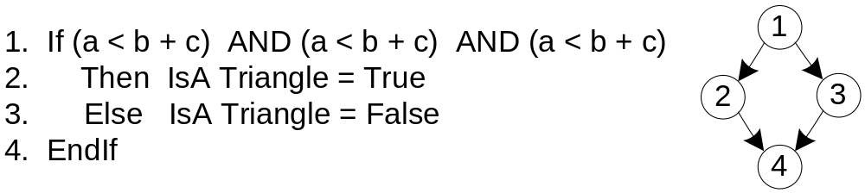
One more example
In the three conditions, there are interesting dependencies that create four impossible rules.

Slide 42
Corresponding Decision Table
Conditions | rule 1 | rule 2 | rule 3 | rule 4 | rule 5 | rule 6 | rule 7 | rule 8
(a < b + c) | T | T | T | T | F | F | F | F
(b < a + c) | T | T | F | F | T | T | F | F
(c < a + b) | T | F | T | F | T | F | T | F
IsATriangle = True | x | — | — | — | — | — | — | —
IsATriangle = False | — | x | x | — | x | — | — | —
impossible | — | — | — | x |  | x | x | x

Slide 43
Two Strategies of MCDC Testing
Rewrite the code as a decision table
  algebraically simplify
  watch for impossible rules
  eliminate masking when possible
Rewrite the code as nested If logic

Slide 44
Test Cases and Coverage
Decision Coverage: Rule 1 and Rule 2. (also, rules 1 and 3, or rules 1 and 5.
Rules 4, 6, 7, and 8 are impossible.
Condition Coverage
  rules 1 and 2 toggle (c < a + b)
  rules 1 and 3 toggle (b < a + c)
  rules 1 and 5 toggle (a < b + c)
Modified Condition Decision Coverage:
  rules 1 and 2 toggle (c < a + b)
  rules 1 and 3 toggle (b < a + c)
  rules 1 and 5 toggle (a < b + c)

Slide 45
Code-Based Testing Strategy
Start with a set of test cases generated by an “appropriate” (depends on the nature of the program) specification-based test method.
Look at code to determine appropriate test coverage metric.
  Loops?
  Compound conditions?
  Dependencies?
If appropriate coverage is attained, fine.
Otherwise, add test cases to attain the intended test coverage.

Slide 46
Test Coverage Tools
Commercial test coverage tools use “instrumented” source code.
  New code added to the code being tested
  Designed to “observe” a level of test coverage
When a set of test cases is run on the instrumented code, the designed test coverage is ascertained.
Strictly speaking, running test cases in instrumented code is not sufficient
  Safety critical applications require tests to be run on actual (delivered, non-instrumented) code.
  Usually addressed by mandated testing standards.

Slide 47
Sample DD-Path Instrumentation
(values of array DDpathTraversed are set to 1 when corresponding instrumented code is executed.)
DDpathTraversed(1) = 1
4. Output("Enter 3 integers which are sides of a triangle")
5. Input(a,b,c)
6. Output("Side A is ",a)
7. Output("Side B is ",b)
8. Output("Side C is ",c)
'Step 2: Is A Triangle?
DDpathTraversed(2) = 1
9. If (a < b + c) AND (b < a + c) AND (c < a + b)
Then DDpathTraversed(3) = 1
IsATriangle = True
Else DDpathTraversed(4) = 1
IsATriangle = False
12 EndIf

Slide 48
Instrumentation Exercise
How could you instrument the Triangle Program to record how many times a set of test cases traverses the individual DD-Paths?
Is this useful information?

Slide 49
Basis Path Testing
Proposed by Thomas McCabe in 1982
Math background
  a Vector Space has a set of independent vectors called basis vectors
  every element in a vector space can be expressed as a linear combination of the basis vectors
Example: Euclidean 3-space has three basis vectors
  (1, 0, 0) in the x direction
  (0, 1, 0) in the y direction
  (0, 0, 1) in the z direction
The Hope: If a program graph can be thought of as a vector space, there should be a set of basis vectors. Testing them tests many other paths.

Slide 50
(McCabe) Basis Path Testing
in math, a basis "spans" an entire space, such that everything in the space can be derived from the basis elements.
the cyclomatic number of a strongly connected directed graph is the number of linearly independent cycles.
given a program graph, we can always add an edge from the sink node to the source node to create a strongly connected graph. (assuming single entry, single exit)
computing V(G) = e - n + p from the modified program graph yields the number of independent paths that must be tested.
since all other program execution paths are linear combinations of the basis path, it is necessary to test the basis paths. (Some say this is sufficient; but that is problematic.)
the next few slides follow McCabe's original example.

Slide 51
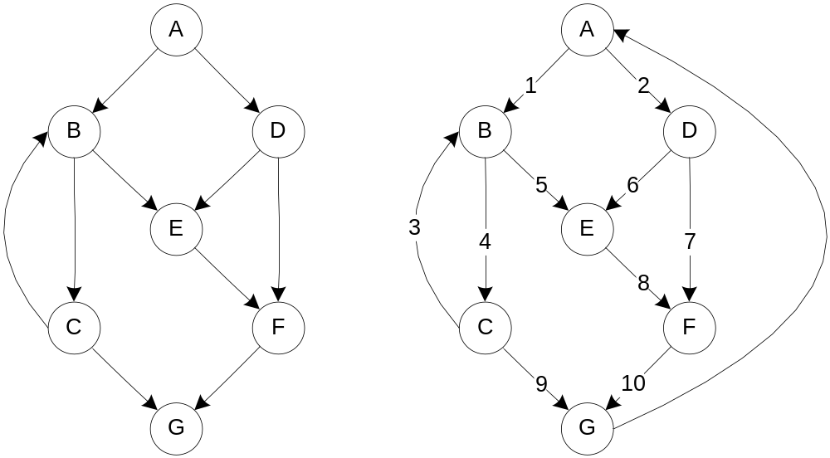
McCabe's Example
McCabe's
Original Graph
Derived, Strongly Connected Graph
V(G) = 10 - 7 + 2(1)
= 5
V(G) = 11 - 7 + 1
= 5

Slide 52
McCabe's Baseline Method
Pick a "baseline" path that corresponds to normal execution. (The baseline should have as many decisions as possible.)
To get succeeding basis paths, retrace the baseline until you reach a decision node. "Flip" the decision (take another alternative) and continue as much of the baseline as possible.
Repeat this until all decisions have been flipped. When you reach V(G) basis paths, you're done.
If there aren't enough decisions in the first baseline path, find a second baseline and repeat steps 2 and 3.
Following this algorithm, we get basis paths for McCabe's
example.

Slide 53
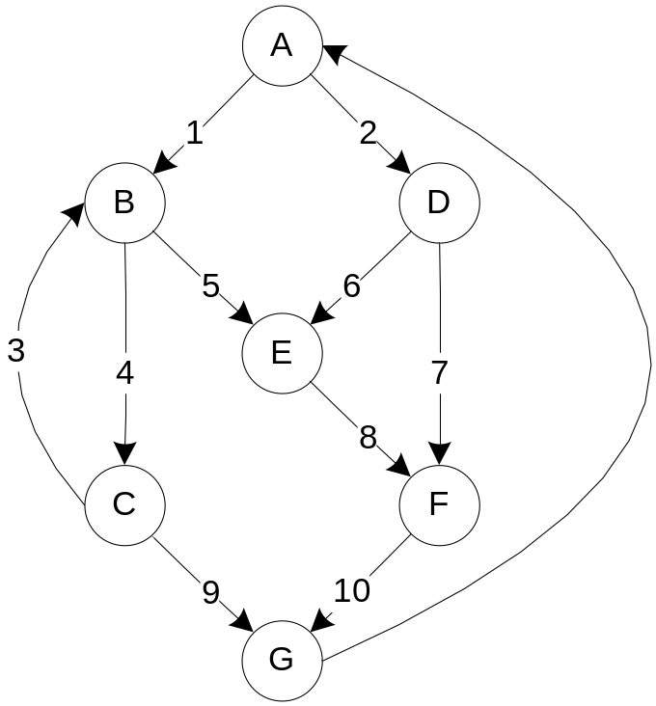
McCabe’s Example (with numbered edges)
Resulting basis paths
First baseline path
p1: A, B, C, G
Flip decision at C
p2: A, B, C, B, C, G
Flip decision at B
p3: A, B, E, F, G
Flip decision at A
p4: A, D, E, F, G
Flip decision at D
p5: A, D, F, G

Slide 54
Path/Edge Incidence
Path / Edges | e1 | e2 | e3 | e4 | e5 | e6 | e7 | e8 | e9 | e10
p1: A, B, C, G | 1 | 0 | 0 | 1 | 0 | 0 | 0 | 0 | 1 | 0
p2: A, B, C, B, C, G | 1 | 0 | 1 | 2 | 0 | 0 | 0 | 0 | 1 | 0
p3: A, B, E, F, G | 1 | 0 | 0 | 0 | 1 | 0 | 0 | 1 | 0 | 1
p4: A, D, E, F, G | 0 | 1 | 0 | 0 | 0 | 1 | 0 | 1 | 0 | 1
p5: A, D, F, G | 0 | 1 | 0 | 0 | 0 | 0 | 1 | 0 | 0 | 1
ex1: A, B, C, B, E, F, G | 1 | 0 | 1 | 1 | 1 | 0 | 0 | 1 | 0 | 1
ex2: A, B, C, B, C, B, C, G | 1 | 0 | 2 | 3 | 0 | 0 | 0 | 0 | 1 | 0
Sample paths as linear combinations of basis paths
ex1 = p2 + p3 - p1
ex2 = 2p2 - p1

Slide 55
Problems with Basis Paths
What is the significance of a path as a linear combination of basis paths?
What do the coefficients mean? What does a minus sign mean?
In the path ex2 = 2p2 - p1 should a tester run path p2 twice, and then not do path p1 the next time? This is theory run amok.
Is there any guarantee that basis paths are feasible?
Is there any guarantee that basis paths will exercise interesting dependencies?

Slide 56
McCabe Basis Paths in the Triangle Program
There are 8 topologically possible paths.
4 are feasible, and 4 are infeasible.
Exercise: Is every basis path feasible?
V(G) = 23 - 20 + 2(1) = 5
Basis Path Set B1
p1: 4, 5, 6, 7, 8, 9, 10, 12, 13, 14, 16, 18, 19, 20, 22, 23 (mainline)
p2: 4, 5, 6, 7, 8, 9, 11, 12, 13, 14, 16, 18, 19, 20, 22, 23 (flipped at 9)
p3: 4, 5, 6, 7, 8, 9, 11, 12, 13, 21, 22, 23 (flipped at 13)
p4: 4, 5, 6, 7, 8, 9, 11, 12, 13, 14, 15, 20, 22, 23 (flipped at 14)
p5: 4, 5, 6, 7, 8, 9, 11, 12, 13, 14, 16, 17, 19, 20, 22, 23 (flipped at 16)

Slide 57
Essential Complexity
McCabe’s notion of Essential Complexity deals with the extent to which a program violates the precepts of Structured Programming.
To find Essential Complexity of a program graph,
  Identify a group of source statements that corresponds to one of the basic Structured Programming constructs.
  Condense that group of statements into a separate node (with a new name)
  Continue until no more Structured Programming constructs can be found.
  The Essential Complexity of the original program is the cyclomatic complexity of the resulting program graph.
The essential complexity of a Structured Program is 1.
Violations of the precepts of Structured Programming increase the essential complexity.

Slide 58
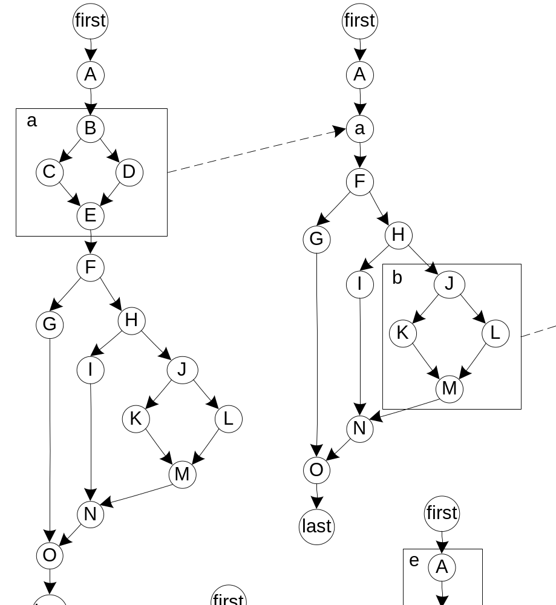
Condensation with Structured Programming Constructs

Slide 59
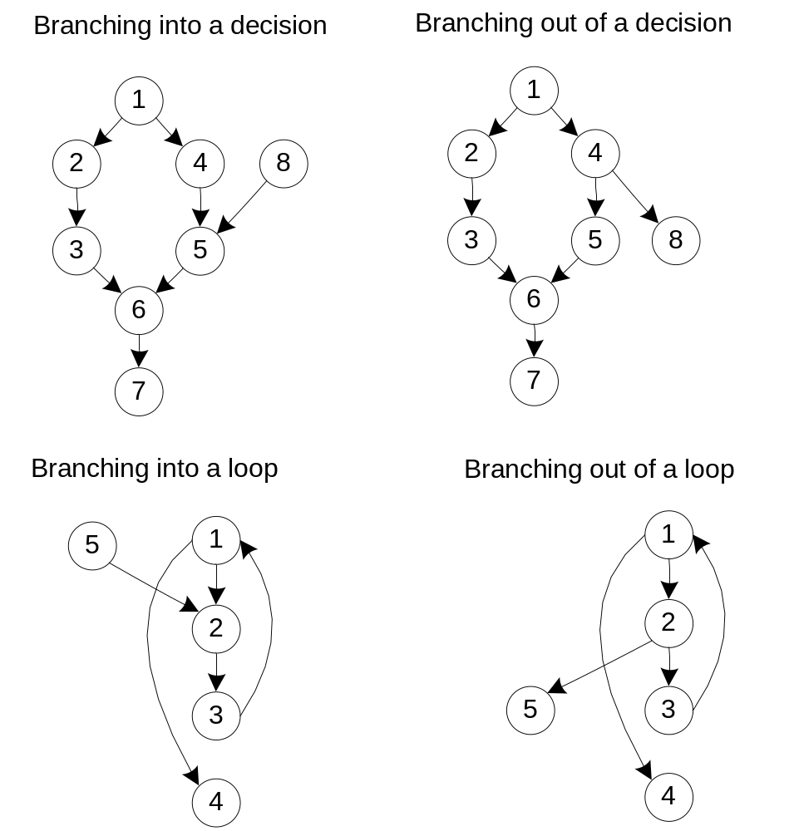
Violations of Structured Programming Precepts

Slide 60
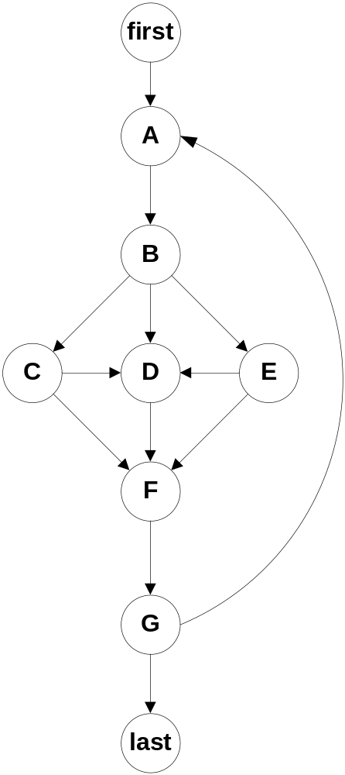
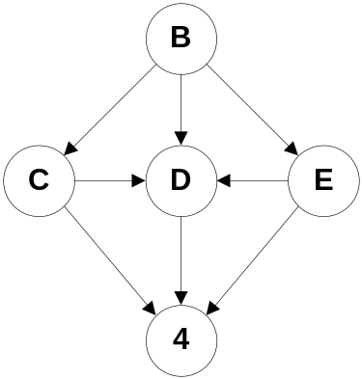
Essential Complexity of Schach’s Program Graph
The
original
Reduces to this
V(G) = 8 – 5 + 2(1)
= 5
Essential complexity is 5

Slide 61
Cons and Pros of McCabe’s Work
Issues
  Linear combinations of execution paths are counter-intuitive. What does 2p2 – p1 really mean?
  How does the baseline method guarantee feasible basis paths?
  Given a set of feasible basis paths, is this a sufficient test?
Advantages
  McCabe's approach does address both gaps and redundancies.
  Essential complexity leads to better programming practices.
  McCabe proved that violations of the structured programming constructs increase cyclomatic complexity, and violations cannot occur singly.

Slide 62
Conclusions For Code-Based Testing
Excellent supplement (complement?) to specification-based testing because..
  highlights gaps and redundancies
  supports a useful range of test coverage metrics
Test coverage metrics help manage the testing process.
Tool support is widely available.
Not much help for identifying test cases.
Satisfaction of a test coverage metric does not guarantee the absence of faults.

Slide 63
Postscript (for mathematicians only!)
For a set V to be a vector space, two operations (addition and
scalar multiplication) must be defined for elements in the set. In
addition, the following criteria must hold for all vectors x, y, and z ϵ V,
and for all scalars k, l, 0, and 1:
a. if x, y ϵ V, the vector x + y ϵ V.
b. x + y = y + x.
c. (x + y) + z = x + (y + z).
d. there is a vector 0 ϵ V such that x + 0 = x.
e. for any x ϵ V, there is a vector -x ϵ V such that x + (-x) = 0.
f. for any x ϵ V, the vector kx ϵ V, where k is a scalar constant.
g. k(x + y) = kx + ky.
h. (k + l)x = kx + lx.
i. k(lx) = (kl)x.
j. 1x = x.

